Slide 1
Data Structures and Algorithms
LECTURE 03: STACK & QUEUE

Slide 2
Overview
Stacks
Array-based stack
Stack implemented by a singly linked list
Stack class in java.util
Queues
Priority Queues
Queue interface in java.util
Reading at home

Slide 3
stack

Slide 4
What is a stack?
A linear data structure
Can be accessed only at one of its ends for storing and retrieving data
A stack is a Last In, First Out (LIFO) data structure
Anything added will go to the top
Anything removed will be taken from the top
Things are removed in the reverse order that they were inserted

Slide 5
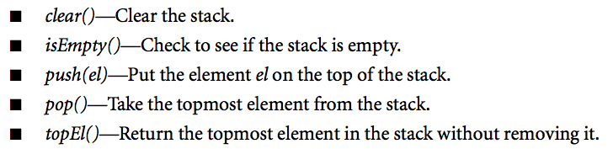
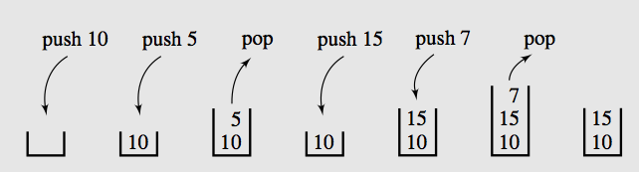
Operations on stack

Slide 6
Stack exceptions
Operations pop and top cannot be performed if the stack is empty
Attempting the execution of pop or top on an empty stack should throws a StackEmptyException
Operations push sometimes cannot be performed if it’s not enough memory
Attempting the execution of push when there is not enough memory should throws a OutOfMemoryError
Notes:
ADT: Abstract Data Type

Slide 7
Applications of stacks
Any sort of nesting (such as parentheses)
Evaluating arithmetic expressions (and other sorts of expression)
Implementing function or method calls
Keeping track of previous choices (as in backtracking)
Keeping track of choices yet to be made (as in creating a maze)
Undo sequence in a text editor
Auxiliary data structure for algorithms
Component of other data structure

Slide 8
Array-based stack
A simple way of implementing the Stack ADT uses an array
We add elements from left to right
A variable top keeps track of the index of the top element

Slide 9
Array-based stack
The array storing the stack elements may become full
A push operation will then throw a OutOfMemoryError
Limitation of the array-based implementation
Not intrinsic to the Stack ADT

Slide 10
Array based Implementation

Slide 11
Functionalities
Common characteristics
Object[] a
int top, max
Constructors
ArrayStack(int max)
ArrayStack() – default max=50
Common behaviors
isEmpty()
isFull()
clear()
grow()
push()
top()
pop()

Slide 12
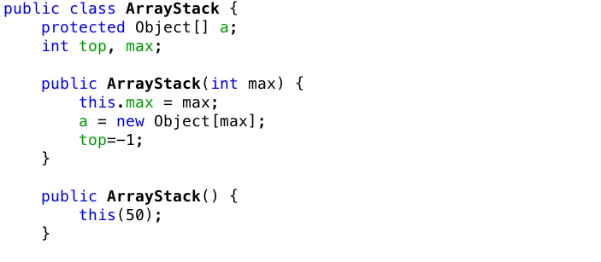
Array implementation of Stack

Slide 13
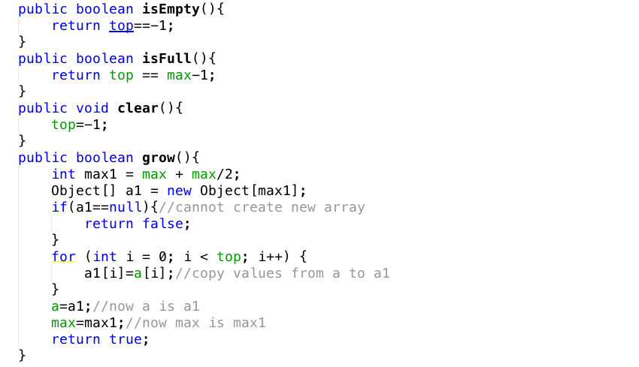
Array implementation of Stack

Slide 14
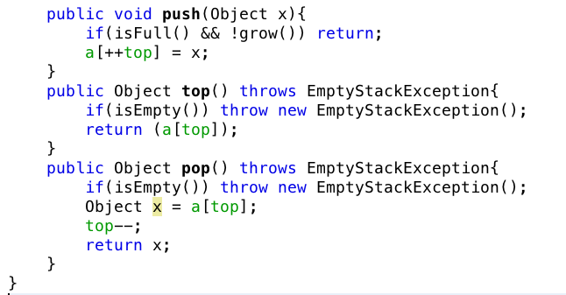
Array implementation of Stack

Slide 15
ArrayList based implementation

Slide 16
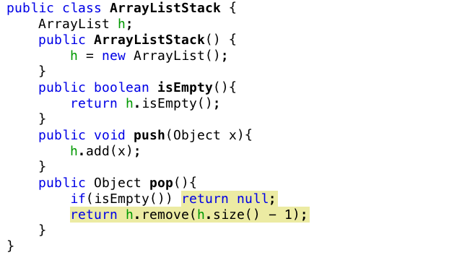
ArrayList Implementation of Stack

Slide 17
LinkedList Implementation of Stack

Slide 18
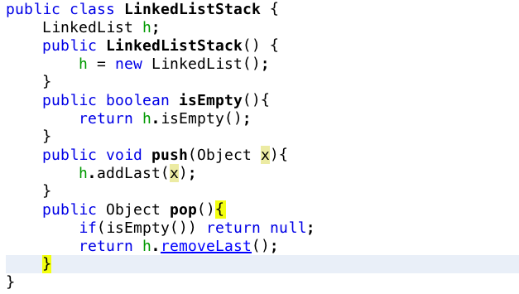
LinkedList implementation of Stack

Slide 19
Use of Stack – Convert 10 to binary
/2
/2
/2
/2
Stop
10
5
2
1
0
%2
%2
%2
%2
0
1
0
1
return
return
return
return
print
print
print
print
0
1
0
1
Values
2⁰
2¹
2²
2³

Slide 20
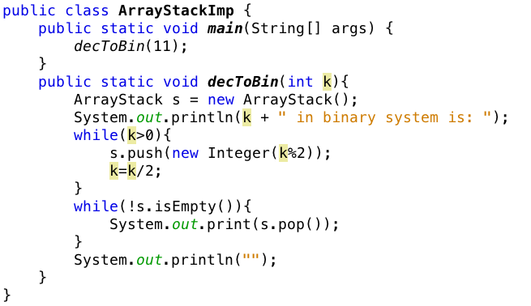
Example using stack

Slide 21
Stack class in Java
Stack class implemented in java.util package is an extension of class Vector
Method | Operation
boolean empty() | Returns true if the stack includes no element and false otherwise
Object peek() | Returns top element on the stack; throw EmptyStackException for empty stack.
Object pop() | Remove the top element of the stack and return it; throw EmptyStackException for empty stack.
Object push(Object el) | Inserts el at the top of the stack and return it.
int search(Object el) | Returns the position of el on the stack (the first position is at the top; -1 in case of failure).
Stack() | Creates an empty stack

Slide 22
Queue

Slide 23
What is a queue?
Queue is a waiting line that grows by adding elements to its end and shrinks by taking elements from its front
A queue is a structure in which both ends are used
One for adding new elements
One for removing them
A queue is a FIFO structure: First In/First Out

Slide 24
Operations on a Queue
The following operations are needed to properly manage a queue:
clear(): clear the queue
isEmpty(): check to see if queue is empty
enqueue(el): put the element at the end of the queue
dequeue(): take the first element and remove it from the queue
front(): return first element without removing it (sometimes is named as peek()).

Slide 25
Exceptions
Attempting the execution of dequeue or front on an empty queue throws an EmptyQueueException
Attempting the execution of enqueuer may throws an OutOfMemoryError

Slide 26
Queue example
Operation | Output | Queue
enqueue(5) | ___ | (5)
enqueue(3) | ___ | (5, 3)
dequeue() | 5 | (3)
enqueue(7) | ___ | (3, 7)
dequeue() | 3 | (7)
front() | 7 | (7)
dequeue() | 7 | ()
dequeue() | “error” | ()
isEmpty() | true | ()
enqueue(9) | ___ | (9)
enqueue(7) | ___ | (9, 7)
size() | 2

Slide 27
Application of Queues
Direct application
Waiting lists
Access to shared resources (e.g., printer)
Multiprogramming
Indirect applications
Auxiliary data structure for algorithms
Component of other data structures

Slide 28
Application: Round Robin Schedulers
Round-robin:
One of simplest scheduling algorithms for processes in OS
Assigns time slices process in equal portions and circular order
Handles all processes without priority.
It has properties:
Simple and easy to implement
Starvation-free
Applications to other problems
Data packet scheduling in computer networks.
Its name comes from round-robin principle
known from other fields
each person takes an equal share of something in turn.

Slide 29
Array based Implementation

Slide 30
Array-based Queue
Use an array of size N in a circular fashion
Two variables keep track of the first and the last
f index of the front element
l index of the last element
Normal configuration
Q
 | 0 | 1 | 2 | … | f |  |  |  | … |  |  |  |  | l
Wrapped-around configuration
Q
 | 0 | 1 | 2 | … | l |  |  |  | … |  |  | f

Slide 31
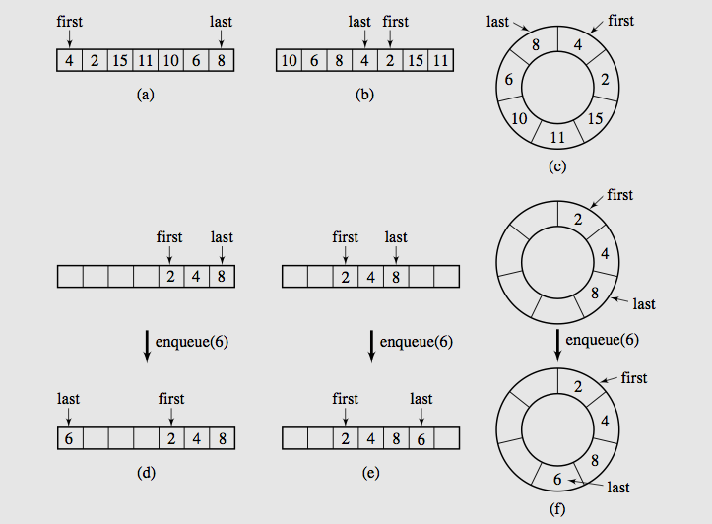
Array based Queue

Slide 32
isFull() cases
Case 1
max
first
last
Case 2
max
last
first
(Already wrapped back and catches first again)

Slide 33
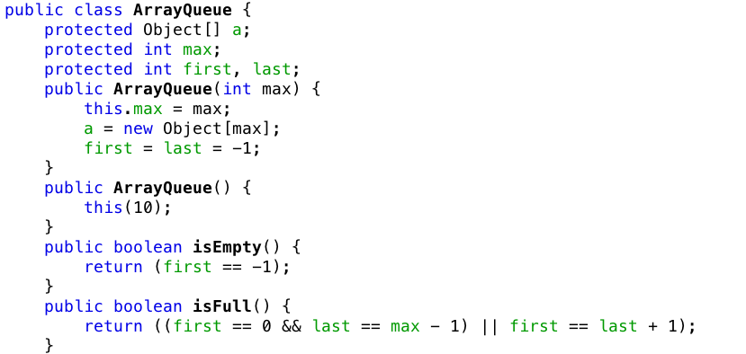
Array implementation of Queue

Slide 34
grow() cases
Case 1: first < last
i=
first
last
0 | 1 | 2 | 3 | 4 | 5 | 6 | 7 | 8 | 9
max
i-first
Size = last – first + 1
0 | 1 | 2 | 3 | 4 | 5 | 6 | 7 | 8 | 9 | 10 | …

Slide 35
grow() cases
Case 2: last < first
j=0
last
i=
first
max-1
0 | 1 | 2 | 3 | 4 | 5 | 6 | 7 | 8 | 9
max
Size = max– first + last
0 | 1 | 2 | 3 | 4 | 5 | 6 | 7 | 8 | 9 | 10 | …
i-first
j+max-first

Slide 36
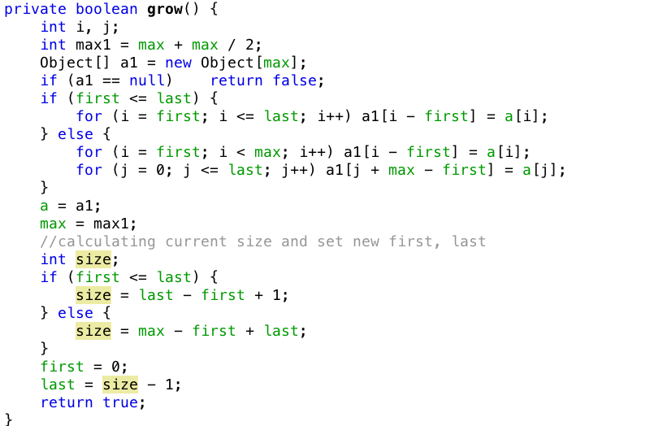
Array implementation of Queue
Mistake:
Need to + 1 here

Slide 37
enqueue() cases
Case 1: first or wrapped back
first
last
0 | 1 | 2 | 3 | 4 | 5 | 6 | 7 | 8 | 9
max
last
first
0 | 1 | 2 | 3 | 4 | 5 | 6 | 7 | 8 | 9
max
Case 2: Normal
last
first
0 | 1 | 2 | 3 | 4 | 5 | 6 | 7 | 8 | 9
max

Slide 38
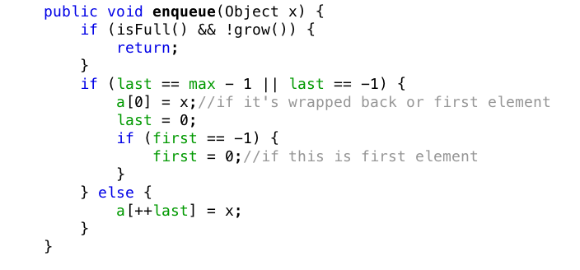
Array implementation of Queue

Slide 39
dequeue() cases
Case 1: only one element (first==last) then first=last=-1
first
last
0 | 1 | 2 | 3 | 4 | 5 | 6 | 7 | 8 | 9
max
Case 2: wrapped back (first==max-1) then first = 0
last
first
0 | 1 | 2 | 3 | 4 | 5 | 6 | 7 | 8 | 9
max
Case 3: otherwise, first++
first
last
0 | 1 | 2 | 3 | 4 | 5 | 6 | 7 | 8 | 9
max

Slide 40
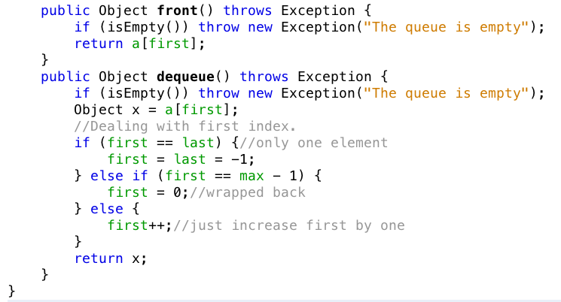
Array implementation of Queue

Slide 41
Linked Implementation of queue

Slide 42
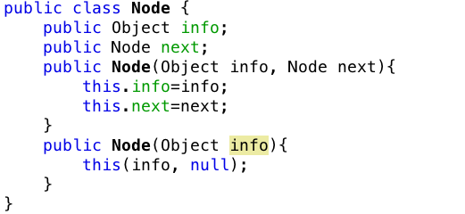
Linked Implementation of a queue

Slide 43
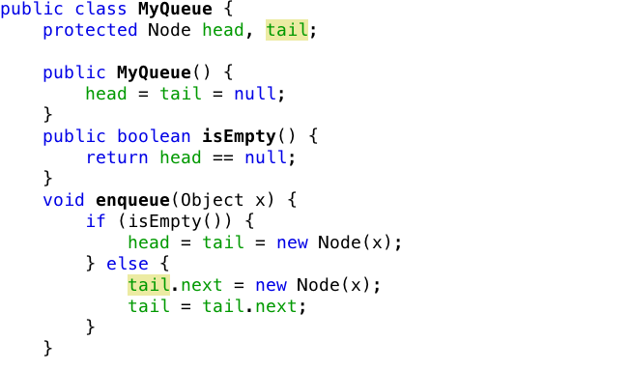
Linked Implementation of a queue

Slide 44
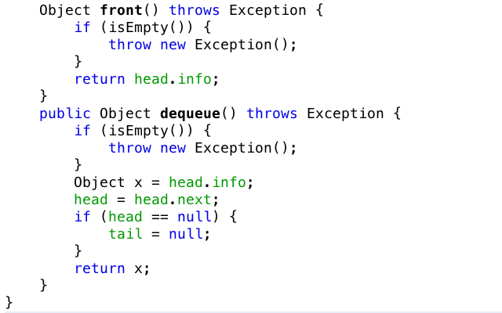
Linked Implementation of a queue

Slide 45
Queue interface and priority queue

Slide 46
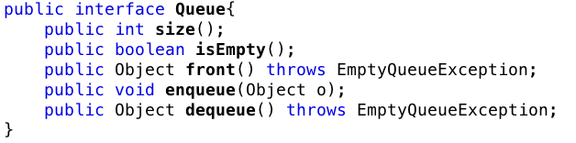
Queue Interface
Java interface corresponding to our Queue ADT
Requires the definition of class EmptyQueueException

Slide 47
Priority queue
Priority queue enables operations out of sequence without affecting overall system operation
FIFO rule is broken in these situations
Elements are de-queued according to their priority and their current queue position.

Slide 48
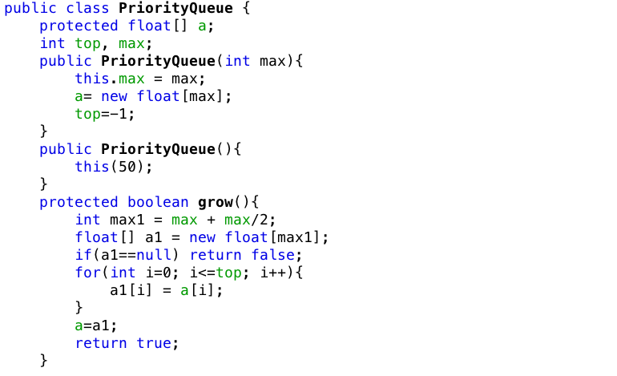
Priority queue implementation
Mistake:
Missing max=max1;

Slide 49
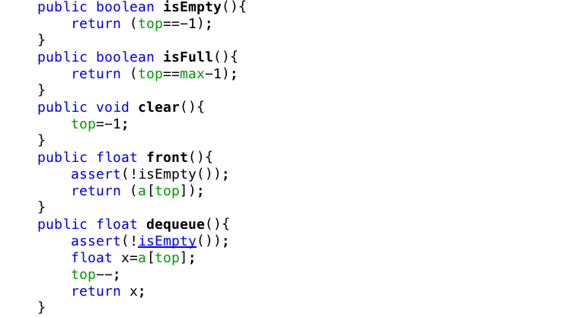
Priority queue implementation

Slide 50
Looking for the right position (priority)
Input order
23
17
45
18
12
22

Slide 51
Looking for the right position (priority)
Input order
23
17
45
18
12
22
1
2
3
4
5
6

Slide 52
Looking for the right position (priority)
Input order
23
17
45
18
12
22
1
2
3
4
5
6
Stored order
1
2
3
4
5
6

Slide 53
Looking for the right position (priority)
Input order
17
45
18
12
22
1
2
3
4
5
6
Stored order
23
1
2
3
4
5
6

Slide 54
Looking for the right position (priority)
Input order
45
18
12
22
1
2
3
4
5
6
Stored order
17
23
1
2
3
4
5
6

Slide 55
Looking for the right position (priority)
Input order
18
12
22
1
2
3
4
5
6
Stored order
17
23
45
1
2
3
4
5
6

Slide 56
Looking for the right position (priority)
Input order
12
22
1
2
3
4
5
6
Stored order
17
18
23
45
1
2
3
4
5
6

Slide 57
Looking for the right position (priority)
Input order
1
2
3
4
5
6
Stored order
12
17
18
22
23
45
1
2
3
4
5
6

Slide 58
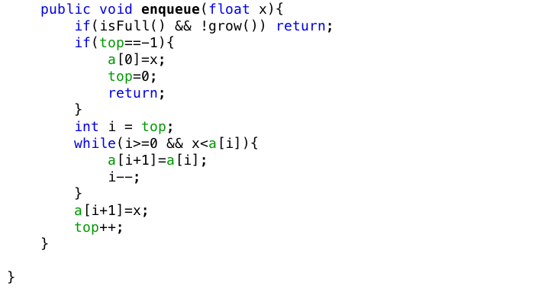
Priority queue implementation

Slide 59
QUEUE in Java

Slide 60
Queue in Java
Java does provide interface for Queue and an Implementation for Priority Queue in the java.util package
java.util.Queue;
java.util.PriorityQueue;

Slide 61
Summaries
Stacks
Array-based stack
Stack implemented by a singly linked list
Stack class in java.util
Queues
Priority Queues
Queue interface in java.util
Reading at home

Slide 62
The end

